Slide 1
Applications’ Security
From SQL Injection
Hemil Chovatiya
200303108003
6ITA
Parul University

Slide 2
Application Vulnerabilities
SQL injection and buffer overflows are hacking techniques used to exploit weaknesses in applications.
When programs are written, some parameters used in the creation of the application code can leave weaknesses in the program.

Slide 3
Application Vulnerabilities
SQL injection is a hacking method used to attack SQL databases
SQL injection and buffer overflows are similar exploits in that they’re both usually delivered via a user input field.
The input field is
  where a user may enter a username and password on a website,
  add data to a URL,
  or perform a search for a keyword in another application.

Slide 4
Application Vulnerabilities
SQL injection and buffer overflow countermeasures are designed to utilize secure programming methods.
By changing the variables used by the application code, weaknesses in applications can be greatly minimized.

Slide 5
SQL Injection
Generally, the purpose of SQL injection is to convince the application to run SQL code that was not intended.
SQL injection occurs when an application processes user-provided data to create a SQL statement without first validating the input.

Slide 6
SQL Injection
The user input is then submitted to a web application database server for execution.
When successfully exploited, SQL injection can give an attacker access to database content or allow the hacker to remotely execute system commands.
In the worst-case scenario, the hacker can take control of the server that is hosting the database.

Slide 7
SQL Injection
This exploit can give a hacker access to a remote shell into the server file system.
The impact of a SQL injection attacks depends on
  where the vulnerability is in the code,
  how easy it is to exploit the vulnerability,
  what level of access the application has to the database.
Theoretically, SQL injection can occur in any type of application, but it is most commonly associated with web applications.
The web applications are easy targets because by their very nature they are open to being accessed from the Internet.

Slide 8
SQL Injection
During a web application SQL injection attack,
  The malicious code is inserted into a web form field
  Or the website’s code to make a system execute a command shell
  Or other arbitrary commands.
Just as a legitimate user enters queries and additions to the SQL database via a web form,
The hacker can insert commands to the SQL Server through the same web form field.

Slide 9
Finding a SQL Injection Vulnerability
Before launching a SQL injection attack, the hacker determines whether the configuration of the database and related tables and variables is vulnerable.
The steps to determine the SQL Server’s vulnerability are as follows:
  Using your web browser, search for a website that uses a login page or other database input or query fields (such as an “I forgot my password” form).
  Look for web pages that display the POST or GET HTML commands by checking the site’s source code.

Slide 10
Finding a SQL Injection Vulnerability
  2.Test the SQL Server using single quotes (‘’). Doing so indicates whether the user input variable is sanitized or interpreted literally by the server.
  If the server responds with an error message that says use 'a'='a' (or something similar), then it’s most likely susceptible to a SQL injection attack.
  Use the SELECT command to retrieve data from the database or the INSERT command to add information to the database.

Slide 11
Finding a SQL Injection Vulnerability
Here are some examples of variable field text you can use on a web form to test for SQL vulnerabilities:
  Blah’ or 1=1--
  Login:blah’ or 1=1--
  Password::blah’ or 1=1--
  http://search/index.asp?id=blah’ or 1=1--

Slide 12
Finding a SQL Injection Vulnerability
These commands and similar variations may allow a user to bypass a login depending on the structure of the database.
When entered in a form field, the commands may return many rows in a table or even an entire database table because the SQL Server is interpreting the terms literally.
The double dashes near the end of the command tell SQL to ignore the rest of the command as a comment.

Slide 13
Finding a SQL Injection Vulnerability
Here are some examples of how to use SQL commands to take control:
To get a directory listing, type the following in a form field:
  Blah‘;exec master..xp_cmdshell “dir c:\*.* /s >c:\directory.txt”--
To create a file, type the following in a form field:
  Blah‘;exec master..xp_cmdshell “echo hacker-was-here > c:\hacker.txt”--
To ping an IP address, type the following in a form field:
  Blah‘;exec master..xp_cmdshell “ping 192.168.1.1”--

Slide 14
The Purpose of SQL Injection
Identifying SQL Injection Vulnerability
  The purpose is to probe a web application to discover which parameters and user input fields are vulnerable to SQL injection.
Performing Database Finger-Printing
  The purpose is to discover the type and version of database that a web application is using and “fingerprint” the database.
  Knowing the type and version of the database used by a web application allows an attacker to craft database specific attacks.

Slide 15
The Purpose of SQL Injection
Determining Database Schema
  To correctly extract data from a database, the attacker often needs to know database schema information, such as table names, column names, and column data types.
  This information can be used in a follow-on attack.
Extracting Data
  These types of attacks employ techniques that will extract data values from the database.
  Depending on the type of web application, this information could be sensitive and highly desirable to the attacker.

Slide 16
The Purpose of SQL Injection
Adding or Modifying Data
  The purpose is to add or change information in a database.
Performing Denial of Service
  These attacks are performed to shut down access to a web application, thus denying service to other users.
  Attacks involving locking or dropping database tables also fall under this category.
Evading Detection
  This category refers to certain attack techniques that are employed to avoid auditing and detection.

Slide 17
The Purpose of SQL Injection
Bypassing Authentication
  The purpose is to allow the attacker to bypass database and application authentication mechanisms.
  Bypassing such mechanisms could allow the attacker to assume the rights and privileges associated with another application user.
Executing Remote Commands
  These types of attacks attempt to execute arbitrary commands on the database. These commands can be stored procedures or functions available to database users.
Performing Privilege Escalation
  These attacks take advantage of implementation errors or logical flaws in the database in order to escalate the privileges of the attacker.

Slide 18
SQL Injection Using Dynamic Strings
Many functions of a SQL database receive static user input where the only variable is the user input fields.
Such statements do not change from execution to execution.
They are commonly called static SQL statements.

Slide 19
SQL Injection Using Dynamic Strings
Some programs must build and process a variety of SQL statements at runtime.
In many cases the full text of the statement is unknown until application execution.
Such statements can, and probably will, change from execution to execution.
So, they are called dynamic SQL statements.

Slide 20
SQL Injection Using Dynamic Strings
Dynamic SQL is an enhanced form of SQL that, unlike standard SQL, facilitates the automatic generation and execution of program statements.
Dynamic SQL is a term used to mean SQL code that is generated by the web application before it is executed.
Dynamic SQL is a flexible and powerful tool for creating SQL strings.

Slide 21
SQL Injection Using Dynamic Strings
It can be helpful when you find it necessary to write code that can adjust to varying databases, conditions, or servers.
Dynamic SQL also makes it easier to automate tasks that are repeated many times in a web application.
A hacker can attack a web-based authentication form using SQL injection through the use of dynamic strings.

Slide 22
SQL Injection Using Dynamic Strings
For example, the underlying code for a web authentication form on a web server may look like the following:
  SQLCommand = “SELECT Username FROM Users WHERE Username = ‘“
  SQLCommand = SQLComand & strUsername
  SQLCommand = SQLComand & “‘ AND Password = ‘“
  SQLCommand = SQLComand & strPassword
  SQLCommand = SQLComand & “‘“
  strAuthCheck = GetQueryResult(SQLQuery)

Slide 23
SQL Injection Using Dynamic Strings
A hacker can exploit the SQL injection vulnerability by entering a login and password in the web form that uses the following variables:
    Username: kimberly
    Password: graves’ OR ‘’=’

Slide 24
SQL Injection Using Dynamic Strings
The SQL application would build a command string from this input as follows:
    SELECT Username FROM Users
    WHERE Username = ‘kimberly’
    AND Password = ‘graves’ OR ‘’=’’

Slide 25
SQL Injection Using Dynamic Strings
This query will return all rows from the user’s database, regardless of whether kimberly is a real username in the database or graves is a legitimate password.
This is due to the OR statement appended to the WHERE clause.
The comparison ‘’=’’ will always return a true result, making the overall WHERE clause evaluate to true for all rows in the table.
This will enable the hacker to log in with any username and password.

Slide 26
SQL Injection Vulnerability Scanning
We can use the HP’s Scrawlr to test for SQL Injection Vulnerabilities
Download Scrawlr from www.HP.com.
Install Scrawlr on your Windows lab PC.
Open the Scrawlr program.
Type a target web address in the URL Of Site To Scan field:
Click the Start button to start the audit of the website for SQL injection vulnerabilities.
Once the SQL injection vulnerability scan is complete, Scrawlr will display additional hosts linked from the scanned site.
It is a best practice to scan the linked sites as well as the main site to ensure no SQL injection vulnerabilities exist.

Slide 27
SQL Injection Countermeasures
The cause of SQL injection vulnerabilities is relatively simple and well understood:
  Insufficient validation of user input.
To address this problem, defensive coding practices, such as encoding user input and validation, can be used when programming applications.
It is a laborious and time-consuming process to check all applications for SQL injection vulnerabilities.

Slide 28
SQL Injection Countermeasures
Another countermeasure for preventing SQL injection is checking user data input and validating the data prior to sending the input to the application for processing.
Some countermeasures to SQL injection are
  Rejecting known bad input
  Sanitizing and validating the input field

Slide 29
SQL Injection ex.

Slide 30
2012 News of SQL attacks
Yahoo! Voices was hacked in July. The attack acquired 453,000 user email addresses and passwords. The perpetrators claimed to have used union-based SQL injection to break in.
LinkedIn.com leaked 6.5 million user credentials in June. A class action lawsuit alleges that the attack was accomplished with SQL injection.
SQL injection was documented as a security threat in 1998, but new incidents still occur every month. Making honest mistakes, developers fail to defend against this means of attack, and the security of online data is at risk for all of us because of it.

Slide 31
Real World Examples
On August 17, 2009, the United States Justice Department charged an American citizen Albert Gonzalez and two unnamed Russians with the theft of 130 million credit card numbers using an SQL injection attack.
In 2008 a sweep of attacks began exploiting the SQL injection vulnerabilities of Microsoft's IIS web server and SQL database server. Over 500,000 sites were exploited.

Slide 32
Important Syntax
  COMMENTS: --
  Example: SELECT * FROM `table` --selects everything
  LOGIC: ‘a’=‘a’
  Example: SELECT * FROM `table` WHERE ‘a’=‘a’
  MULTI STATEMENTS: S1; S2
  Example: SELECT * FROM `table`; DROP TABLE `table`;

Slide 33
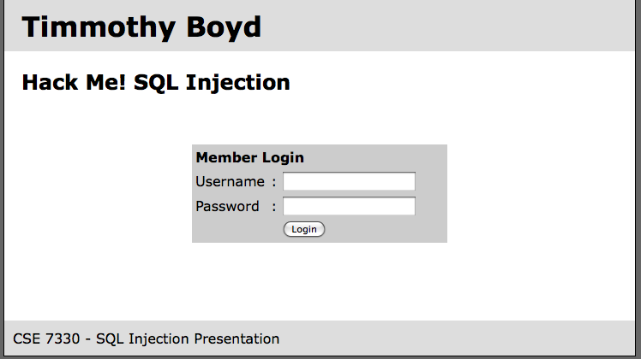
Example Website

Slide 34
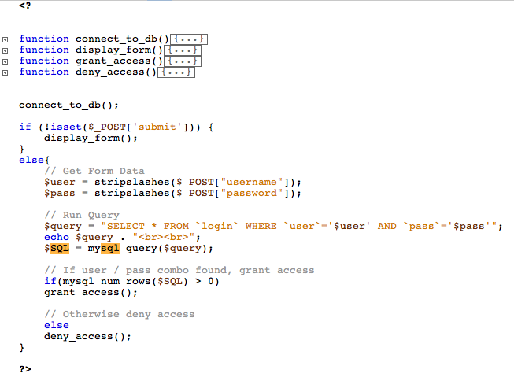

Slide 35
Example Website
timbo317
cse7330
SELECT * FROM `login` WHERE `user`=‘timbo317’ AND `pass`=‘cse7330’

Slide 36
Login Database Table
user | pass
timbo317 | cse7330

Slide 37
Example Hack
’ OR ‘a’=‘a
’ OR ‘a’=‘a
SELECT * FROM `login` WHERE `user`=‘’ OR ‘a’=‘a’ AND
`pass`=‘’ OR ‘a’=‘a’

Slide 38
It Gets Worse!
’; DROP TABLE `login`; --
SELECT * FROM `login` WHERE `user`=‘’; DROP TABLE `login`; --’ AND
`pass`=‘’

Slide 39
All Queries are Possible
SELECT * FROM `login` WHERE `user`=‘’; INSERT INTO `login` ('user','pass') VALUES ('haxor','whatever');--’ AND `pass`=‘’
SELECT * FROM `login` WHERE `user`=‘’; UPDATE `login` SET `pass`=‘pass123’ WHERE `user`=‘timbo317’;--’ AND `pass`=‘’

Slide 40
Prevention
Logic to allow only numbers / letters in username and password.
How should you enforce the constraint?
SERVER SIDE.
‘ESCAPE’ bad characters.
’ becomes \’
READ ONLY database access.
Remember this is NOT just for login areas!
NOT just for websites!!

